Slide 1
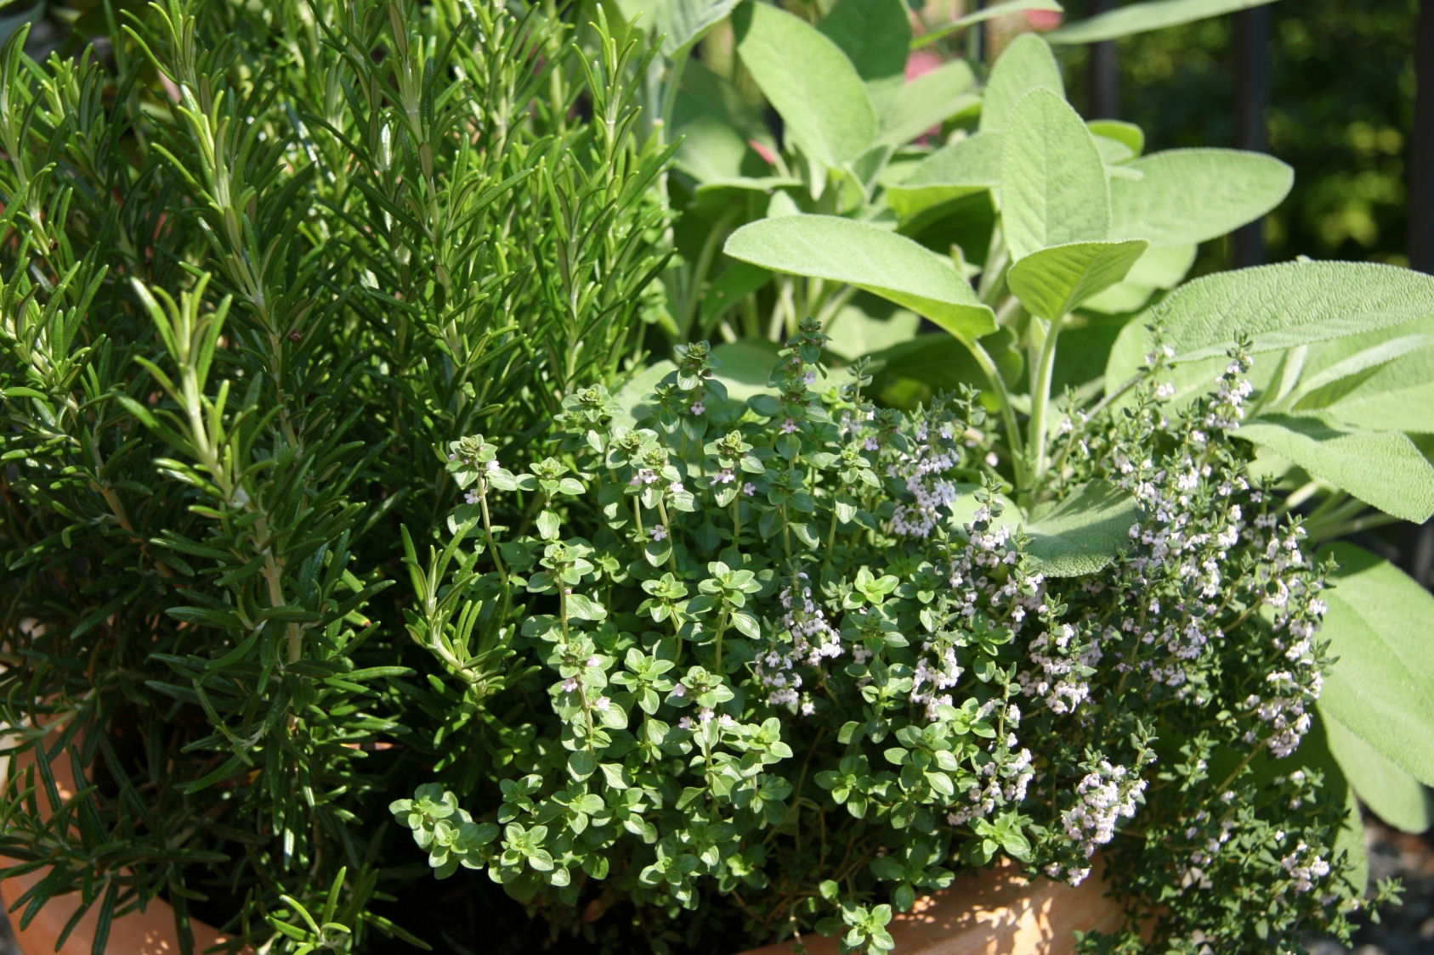
Herbs
for your
Health

Slide 2
Use caution and common sense
This program is intended to give information only
Herbs have been used throughout many centuries, however this program is not intended to substitute for any treatment that may be prescribed by your doctor
You need to consult your doctor before taking herbs if you are on any medications
Women who are pregnant, considering becoming pregnant or breastfeeding should not be using herbs without the approval of their doctor

Slide 3
What is a Phytochemical?
Phytochemicals are non-nutritive plant chemicals that have protective or disease preventive properties. They are nonessential nutrients, meaning that they are not required by the human body for sustaining life. It is well-known that plant produce these chemicals to protect themselves but recent research demonstrate that they can also protect humans against diseases. There are more than a thousand known phytochemicals. Some of the well-known phytochemicals are lycopene in tomatoes, isoflavones in soy and flavanoids in fruits.
Notes:
disclaimer

Slide 4
How do phytochemicals work?
Antioxidant - protect our cells against oxidative damage and reduce the risk of developing certain types of cancer - allyl sulfides (onions, leeks, garlic), carotenoids (fruits, carrots), flavonoids (fruits, vegetables), polyphenols (tea, grapes)
Hormonal action - Isoflavones, found in soy, imitate human estrogens and help to reduce menopausal symptoms and osteoporosis
Notes:
There are many phytochemicals and each works differently. These are some possible actions:

Slide 5
How do phytochemicals work?
Stimulation of enzymes - Indoles, which are found in cabbages, stimulate enzymes that make the estrogen less effective and could reduce the risk for breast cancer. Other phytochemicals, which interfere with enzymes, are protease inhibitors (soy and beans), terpenes (citrus fruits and cherries)
Interference with DNA replication - Saponins found in beans interfere with the replication of cell DNA, thereby preventing the multiplication of cancer cells. Capsaicin, found in hot peppers, protects DNA from carcinogens.
Notes:
There are many phytochemicals and each works differently. These are some possible actions:

Slide 6
How do phytochemicals work?
Anti-bacterial effect - The phytochemical allicin from garlic has anti-bacterial properties
Physical action - Some phytochemicals bind physically to cell walls thereby preventing the adhesion of pathogens to human cell walls. Proanthocyanidins are responsible for the anti-adhesion properties of cranberry. Consumption of cranberries will reduce the risk of urinary tract infections and will improve dental health

Slide 7
Use plants whole
Every plant has in it something toxic if separated or isolated eg chlorophyll (80mg of chlorophyll will kill mice if injected into mice)
The 300-400 micro-flora in out intestines all have a job to do. Each deals with specific chemicals found in the plant. Take these chemicals separately and they could kill us
Use herbs synergistically, they work better in combinations

Slide 8
Extracts of herbs
In the 1970’s saffrol was extracted from the herb saffafras, they injected 1950mg of this into mice and the mice died
Lobelene was extracted from lobelia, 37mg was injected into mice and they died
With this ratio, comparing our body weight with that of mice, it would take 2 kg of lobelia injected to kill us

Slide 9
Doctrine of Signatures
This teaches us that God has placed a sign in every plant indicating its medicinal use
Each part of the plant (leaves, petals, flower, berries, nuts etc) resemble various parts of the body and can be used to treat ailments of that part of the body
Notes:
The "Doctrine of Signatures" was popularized in the early 1600s by the writings of Jakob Böhme (1575-1624), a master shoemaker in the small town of Görlitz, Germany
walnuts were good for curing head ailments because "they have the perfect Signatures of the Head".
Regarding St. John’s Wort (hypericum), he said that, "the little holes whereof the leaves of Saint Johns Wort are full, does resemble all the pores of the skin and therefore it is profitable for all hurts and wounds that can happen thereunto."
And it is Nicholas Culpeper’s repeatedly reprinted "Culpeper’s Color Herbal" (I have the 1983 edition) that takes the Doctrine of Signatures as common knowledge. The influence of this book is where the Doctrine carries over into modern herbal lore.
To fully appreciate the significance of this Doctrine of Signatures, it is important to go back to Paracelsus. Underlying Paracelsus’ treatise was the premise that nature was itself a living organism which must be considered an expression of "the One Life" and that man and the universe are the same in their essential nature. It was Paracelsus who popularized the concept that the Creator has placed his seal on plants to indicate their medicinal uses.
When looking carefully at nature, Paracelsus noticed how the qualities of plants often reflected their appearance—that the seeds of skullcap, for example, resemble small skulls. The herb has been known to be effective in the treatment of brain and nervous system disorders. He also noticed that the hollow stalk of garlic resembles the windpipe, lending to its use for throat and bronchial problems. Due to his observations, Paracelsus believed the inner nature of plants may be discovered by their outer forms or "signatures." He applied this principle to food as well as medicine, remarking that "it is not in the quantity of food but in its quality that resides the Spirit of Life"—a belief familiar to those who choose to eat organic food while also being justifiably concerned over Genetically Modified substitutes that lack the "life force," or spirit.
According to Paracelsus, connecting to the essence of a plant is the gateway to its spirit or consciousness .¹ For the last several years, an email has been forwarded (to us, multiple times) that illustrates this concept with food and how God’s signature is inherent in the food we eat. Validation of this concept is now being proven scientifically through nutritional science. The content of the email speaks for itself:
[Quote] Whole food signatures
A stupendous insight of civilisations past has now been confirmed by today’s investigative, nutritional sciences. They have shown that what was once called "The Doctrine of Signatures" was astoundingly correct.
Referred to in the classical period of Rome as the "Law of Similarities" it is now called by scientists, "Teleological Nutritional Targeting."
It now contends that every whole food has a pattern that resembles a body organ or physiological function and that this pattern acts as a signal or sign as to the benefit the food provides the eater.
A sliced Carrot looks like the human eye. The pupil, iris and radiating lines look just like the human eye... and YES, science now shows carrots greatly enhance blood flow to and function of the eyes.
A Tomato has four chambers and is red. The heart has four chambers and is red. All of the research shows tomatoes are loaded with lycopine and are indeed pure heart and blood food.
Grapes hang in a cluster that has the shape of the heart. Each grape looks like a blood cell and all of the research today shows grapes are also profound heart and blood vitalizing food.
A Walnut looks like a little brain, a left and right hemisphere, upper cerebrums and lower cerebellums. Even the wrinkles or folds on the nut are just like the neo-cortex. We now know walnuts help develop more than three dozen neuro-transmitters for brain function.
Kidney beans actually heal and help maintain kidney function and yes, they look exactly like the human kidneys.
Celery, bok choy, rhubarb and many more look just like bones. These foods specifically target bone strength. Bones are 23 percent sodium and these foods are 23 percent sodium. If you don’t have enough sodium in your diet, the body pulls it from the bones, thus making them weak. These foods replenish the skeletal needs of the body.
Avocadoes, eggplant and pears target the health and function of the womb and cervix of the female—they look just like these organs. Today’s research shows that when a woman eats one avocado a week, it balances hormones, sheds unwanted birth weight, and prevents cervical cancers. And how profound is this? It takes exactly nine months to grow an avocado from blossom to ripened fruit. There are over 14,000 photolytic chemical constituents of nutrition in each one of these foods (modern science has only studied and named about 141 of them).
Figs are full of seeds and hang in twos when they grow. Figs increase the mobility of male sperm and increase the numbers of Sperm as well to overcome male sterility.
Sweet Potatoes look like the pancreas and actually balance the glycemic index of diabetics.
Olives assist the health and function of the ovaries
Oranges, Grapefruits, and other Citrus fruits look just like the mammary glands of the female and actually assist the health of the breasts and the movement of lymph in and out of the breasts.
Onions look like the body’s cells. Today’s research shows onions help clear waste materials from all of the body cells. They even produce tears which wash the epithelial layers of the eyes.

Slide 10
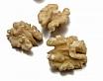
A sliced Carrot looks like the human eye
Grapes hang in a cluster that has the shape of the heart and like a blood cell
A Walnut looks like a little brain
Onions look like the body's cells. Today's research shows onions help clear waste materials from all of the body cells. They even produce tears which wash the epithelial layers of the eyes.. A working companion, Garlic, also helps eliminate waste
Notes:
A friend sent this to me. It's been said that God first separated the salt water from the fresh, made dry land, planted a garden, made animals and fish... All before making a human. He made and provided what we'd need before we were born. These are best & more powerful when eaten raw. We're such slow learners...
God left us a great clue as to what foods help what part of our body!
God's Pharmacy! Amazing! A sliced Carrot looks like the human eye. The pupil iris and radiating lines look just like the human eye... And YES, science now shows carrots greatly enhance blood flow to and function of the eyes. A Tomato has four chambers and is red. The heart has four chambers and is red. All of the research shows tomatoes are loaded with lycopine and are indeed pure heart and blood food. Grapes hang in a cluster that has the shape of the heart. Each grape looks like a blood cell and all of the research today shows grapes are also profound heart and blood vitalizing food. A Walnut looks like a little brain, a left and right hemisphere, upper cerebrums and lower cerebellums. Even the wrinkles or folds on the nut are just like the neo-cortex. We now know walnuts help develop more than three (3) dozen neuron-transmitters for brain function. Kidney Beans actually heal and help maintain kidney function and yes, they look exactly like the human kidneys. Celery, Bok Choy, Rhubarb and many more look just like bones. These foods specifically target bone strength. Bones are 23% sodium and these foods are 23% sodium. If you don't have enough sodium in your diet, the body pulls it from the bones, thus making them weak. These foods replenish the skeletal needs of the body. Avocadoes, Eggplant and Pears target the health and function of the womb and cervix of the female - they look just like these organs. Today's research shows that when a woman eats one avocado a week, it balances hormones, sheds unwanted birth weight, and prevents cervical cancers. And how profound is this? It takes exactly nine (9 ) months to grow an avocado from blossom to ripened fruit. There are over 14,000 photolytic chemical constituents of nutrition in each one of these foods (modern science has only studied and named about 141 of them). Figs are full of seeds and hang in twos when they grow. Figs increase the mobility of male sperm and increase the numbers of Sperm as well to overcome male sterility. Sweet Potatoes look like the pancreas and actually balance the glycemic index of diabetics. Olives assist the health and function of the ovaries Oranges, Grapefruits, and other Citrus fruits look just l ike the mammary glands of the female and actually assist the health of the breasts and the movement of lymph in and out of the breasts.. Onions look like the body's cells. Today's research shows onions help clear waste materials from all of the body cells. They even produce tears which wash the epithelial layers of the eyes.. A working companion, Garlic, also helps eliminate waste

Slide 11
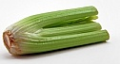
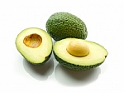
Kidney Beans actually heal and help maintain
kidney function
Celery, Bok Choy, Rhubarb and many more look just like bones
Avocadoes, Eggplant and Pears target the health and function of the womb and cervix of the female
Onions look like the body's cells. Today's research shows onions help clear waste materials from all of the body cells. They even produce tears which wash the epithelial layers of the eyes.. A working companion, Garlic, also helps eliminate waste

Slide 12
Figs are full of seeds and hang in twos when they grow. Figs increase the mobility of male sperm and increase the numbers of Sperm as well to overcome male sterility
Sweet Potatoes look like the pancreas and actually balance the glycemic index of diabetics
Olives assist the health and function of the ovaries

Slide 13
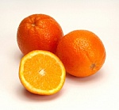
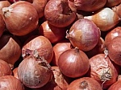
Oranges, grapefruits, and other citrus fruits look just like the mammary glands of the female and actually assist the health of the breasts and the movement of lymph in and out of the breasts
Onions look like the body's cells. They help clear waste materials from all of the body cells. They even produce tears which wash the epithelial layers of the eyes. A working companion, garlic, also helps eliminate waste
A tomato has four chambers and is red. The heart has four chambers and is red. Tomatoes are loaded with lycopine and are indeed pure heart and blood food

Slide 14
Alfalfa - Lucerne

Slide 15
Alfalfa
Richest of foods - helpful for every condition of the body, builds vigour
Rich in minerals (esp calcium), vitamins (D, B12), protein, balances hormones, enzymes
Alleviates anemia, strengthens blood vessels
Notes:
Tap root goes down 12-100metres ... Rich in trace elements... First 3 weeks of growth... The root grows 10x faster that the stem
Father of all foods ...Arabs
Family in Nazi concentration camp.. Ate a few leaves a day maintaining health while those around suffered malnutrition
Extremely rich in calcium... Will repair tooth damage and strengthen structure of teeth
Regulates Hormones – balances either high estrogen or low estrogen
Blood vessels... Dissipates bruising, stops hardening of the arteries
Helps digestion

Slide 16
Alfalfa
Alleviates bowel problems, peptic ulcers, eliminates fungi, helps digest proteins, helps digestion
Absorbs excess dietary cholesterol, helps prevent diabetes, lowers elevated blood sugar, helps detoxify the liver
Notes:
Tap root goes down 12-100metres ... Rich in trace elements... First 3 weeks of growth... The root grows 10x faster that the stem
Father of all foods ...Arabs
Family in Nazi concentration camp.. Ate a few leaves a day maintaining health while those around suffered malnutrition
Regulates Hormones – balances either high estrogen or low estrogen
Blood vessels... Dissipates bruising, stops hardening of the arteries
Helps digestion

Slide 17
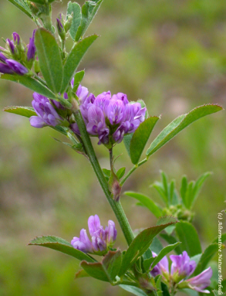
Alfalfa
Counteracts excess acidity in rheumatoid arthritis, regenerates the skin and softens brittle hair, benefits the pituitary gland, alleviates sinusitis
Toxemia, jaundice, neuralgia, insomnia, nerves, constipation, lumbago, edema, skin eruptions, breastfeeding
Caution: Aggravates lupus (seeds and sprouts), warfarin, pregnancy
Notes:
Protein content.... Higher than beef, milk, eggs
It contains vitamin D and lots of other vitamins, B12 found in sprouts.... B12 is heat sensitive so it is lost in cooking (raw meat? Who eats raw meat?)
After childbirth shortens bleeding time

Slide 18
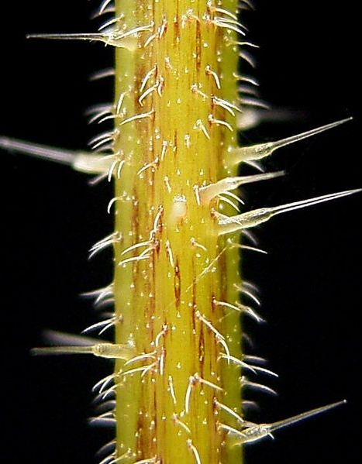
Stinging Nettle

Slide 19
Stinging Nettle
Very good blood purifier, anemia, stimulates circulation, alleviates low blood pressure
Constipation, intestinal parasites, increases production of urine
Allergies (itching eyes, ears or throat), some cancers (prostate), stimulates immune system, inhibits some viruses (HIV, influenza, respiratory)
Notes:
Great herb.. undervalued
Painful sting
Good during menstruation, Not for HBP

Slide 20
Stinging Nettle
Osteoarthritis, rheumatoid arthritis (neutralizes uric acid), gout, takes oxygen to vital organs
Alleviates asthma, hay fever, rhinitis, sinusitis, improves lactation, contains serotonin
Used for centuries for pain relief, Roman soldiers used it to warm themselves and protect against cold and damp
Notes:
Great herb.. undervalued
Painful sting
Good during menstruation, Not for HBP

Slide 21
Stinging Nettle
Fever, colds, phlegm and mucus conditions, bronchitis, neuralgia, sciatica, lumbago, neuritis, tendonitis, backache, liver, kidney and bladder ailments, stones, stomach ulcers, corrects blood sugar levels, iron deficiency, low energy, fatigue, dizzy spells, varicose vein, edema, depression, hysteria, mood swings, heavy menstrual bleeding, strengthens pancreas, thymus, thyroid, adrenals plus all glands in body, increases virility, rebuilds mother’s energy after childbirth
Notes:
Great herb.. undervalued
Painful sting
Good during menstruation, Not for HBP

Slide 22
Stinging Nettle
Balances hormones, combine with Saw Palmetto for treatment of enlarged prostate
This combination used daily for 12 weeks caused an 26% increase in urinary flow, 45% reduction in residual urine, 50% reduction in nocturia, and 53% decrease in post-void dribbling in enlarged prostate patients (average 43.5%)
Caution: Can raise blood pressure

Slide 23
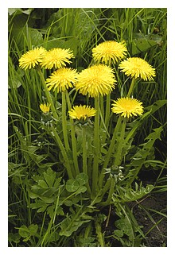
Dandelion

Slide 27
Dandelion
Appears after winter, bitter, use leaves, roots, stems (hollow)
Full of nutritive salts which purify the blood and destroy acid in the blood, anemia (caused by lack of nutritive salts), improves circulation
Great liver tonic, stimulates bile flow, alleviates colitis, constipation, gall stones
Helps kidney function, scanty urine, bed wetting
Notes:
Hard winters... Canned foods, any foods stored, beans, wheat etc ... Shoots, give liver a spring clean
thought to be used at passover
Eat 5 stems a day for 2 weeks
Can be cooked... Reduces nutrition
Highest nutritive content in roots in Autumn
Bed wetting.. Eliminates toxins from body via the kidneys

Slide 28
Dandelion
Stimulates spleen, regulates blood sugar, alleviates Diabetes Mellitus (1 cup 3 times daily), congestion of liver (1 cup 2 x daily – strong decoction), jaundice, obesity, reduces severity of hepatitis
Helps arthritis, rheumatism, acne, skin blemishes, edema
Used as a poultice is a traditional treatment for breast cancer, sap alleviates warts
Notes:
Blood sugar, works on pancreas
Liver Dr Sparks (1900).. An old nurse told him how to help his liver complaint... Found it worked

Slide 29
Cat’s Claw

Slide 30
Cat’s Claw
Bark used, used for years by natives in Peru and discovered anew in 1974. Shared at International Congress in Lima in 1988
“It has so many therapeutic applications that it seems to far surpass such well known herbs as Pau d’Arco, echinacea, goldenseal, astragalus, siberian and panax ginseng... As well as other natural products including grapefruit seed extract, caprylic and lauric acid and shark cartilage.” Vines: Cambridge University press 1991 - Steinberg

Slide 31
Cat’s Claw
Atherosclerosis (inhibits plaque forming), thins blood, prevents heart attacks, lowers blood pressure, helps prevent strokes, alleviates thrombosis
Crohn’s disease, diverticulitis, dysentery, gastritis, cleans entire gastro intestinal tract, alleviates intestinal parasites, improves intestinal health, alleviates irritable bowel syndrome and ulcerative colitis, leaky gut

Slide 32
Cat’s Claw
Great and consistent benefit in treating cancer including brain, minimizes toxic side effects of chemotherapy and radiation therapy, reduces sizes of some skin cancers
Inhibits progression of many viral diseases including AIDS (activates immune system of those infected with HIV and prevents the onset of full blown AIDS in people infected with HIV), alleviates herpes , shingles, influenza and Ross River viruses

Slide 33
Cat’s Claw
Alleviates allergies, lupus, reduces inflammation
Possesses antioxidants, helps chronic fatigue syndrome (after using for one month), diabetes and its complications, increases stamina
Cancer, arthritis, is a powerful cellular rejuvenator, gastritis, ulcers, arthritis, rheumatism, irregularities of the female cycle, acne, depression, fungus
Notes:
Evidence of phytochemicals and alkaloid (plant chemical containing nitrogen) content may distinguish it as a wonder herb of the 21st century

Slide 34
Cat’s Claw
Alleviates bursitis, rheumatoid arthritis, Alzheimer’s, depression, asthma, yeast infections, female hormonal imbalance
Minimizes the toxicity of tobacco smoking, herbicides, pesticides, smog, car exhaust, x-rays, rancid fats, alcohol, stress, poor diet, gamma radiation
Notes:
Evidence of phytochemicals and alkaloid (plant chemical containing nitrogen) content may distinguish it as a wonder herb of the 21st century

Slide 35
Licorice Root

Slide 36
Licorice Root
Counteracts excessive stress, helpful in treating hypoglycemia (low blood pressure by affecting the adrenal hormones), possesses antioxidants, inhibits toxins to damage the liver, alleviates cirrhosis, hepatitis, hepatitis B, inhibits oxidation of LDL cholesterol (main causes of heart attacks and strokes)
The body stores energy in certain organ like the liver, spleen, adrenals. When one becomes weak, it borrows this stored energy and this causes imbalance. Overuse of stimulants like tea, coffee weaken adrenals.
Notes:
People who are under extreme stress cause the adrenals to be overworked. In today’s world we can this hypoglycemia.
High sugar intake leaches B vitamins and calcium causes us inability to handle stress.
Licorice builds endurance, rebuilds adrenals (along with Hawthorn Berries)
50x sweeter than sugar
Liver... Blood cleanser
Dark circle under eyes

Slide 37
Licorice Root
Contains precursors for the production of adrenal hormones, protects cell membranes, alleviates colic, colitis, diverticulosis, cleanses colon, nausea, coughs, heals peptic, duodenal and gastric ulcers
Reduces fevers, suppresses inflammation, allergies, Lupus, inhibits some viruses – HIV, AIDS, Epstein-Barr, herpes and influenza
Alleviates inflammatory joint disease, rheumatoid arthritis, soothes inflamed mucous membranes

Slide 38
Licorice Root
Heals mouth ulcers, prevents tooth decay, quenches thirst, alleviates bronchitis (add to honey and onion), common cold, sore throat
Alleviates painful menstruation, strengthen female reproductive system, helps female hormones, alleviates eczema, keeps you awake, helps when giving up smoking
Caution: Will elevate blood pressure, avoid if you have kidney or liver ailments
Notes:
Alexander the Great ... Army... Used chewed licorice root
Bronchitis, added to cough medicine

Slide 39
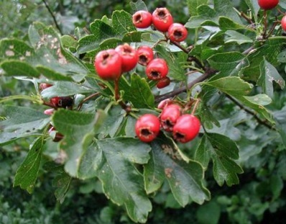
Hawthorn Berry

Slide 40
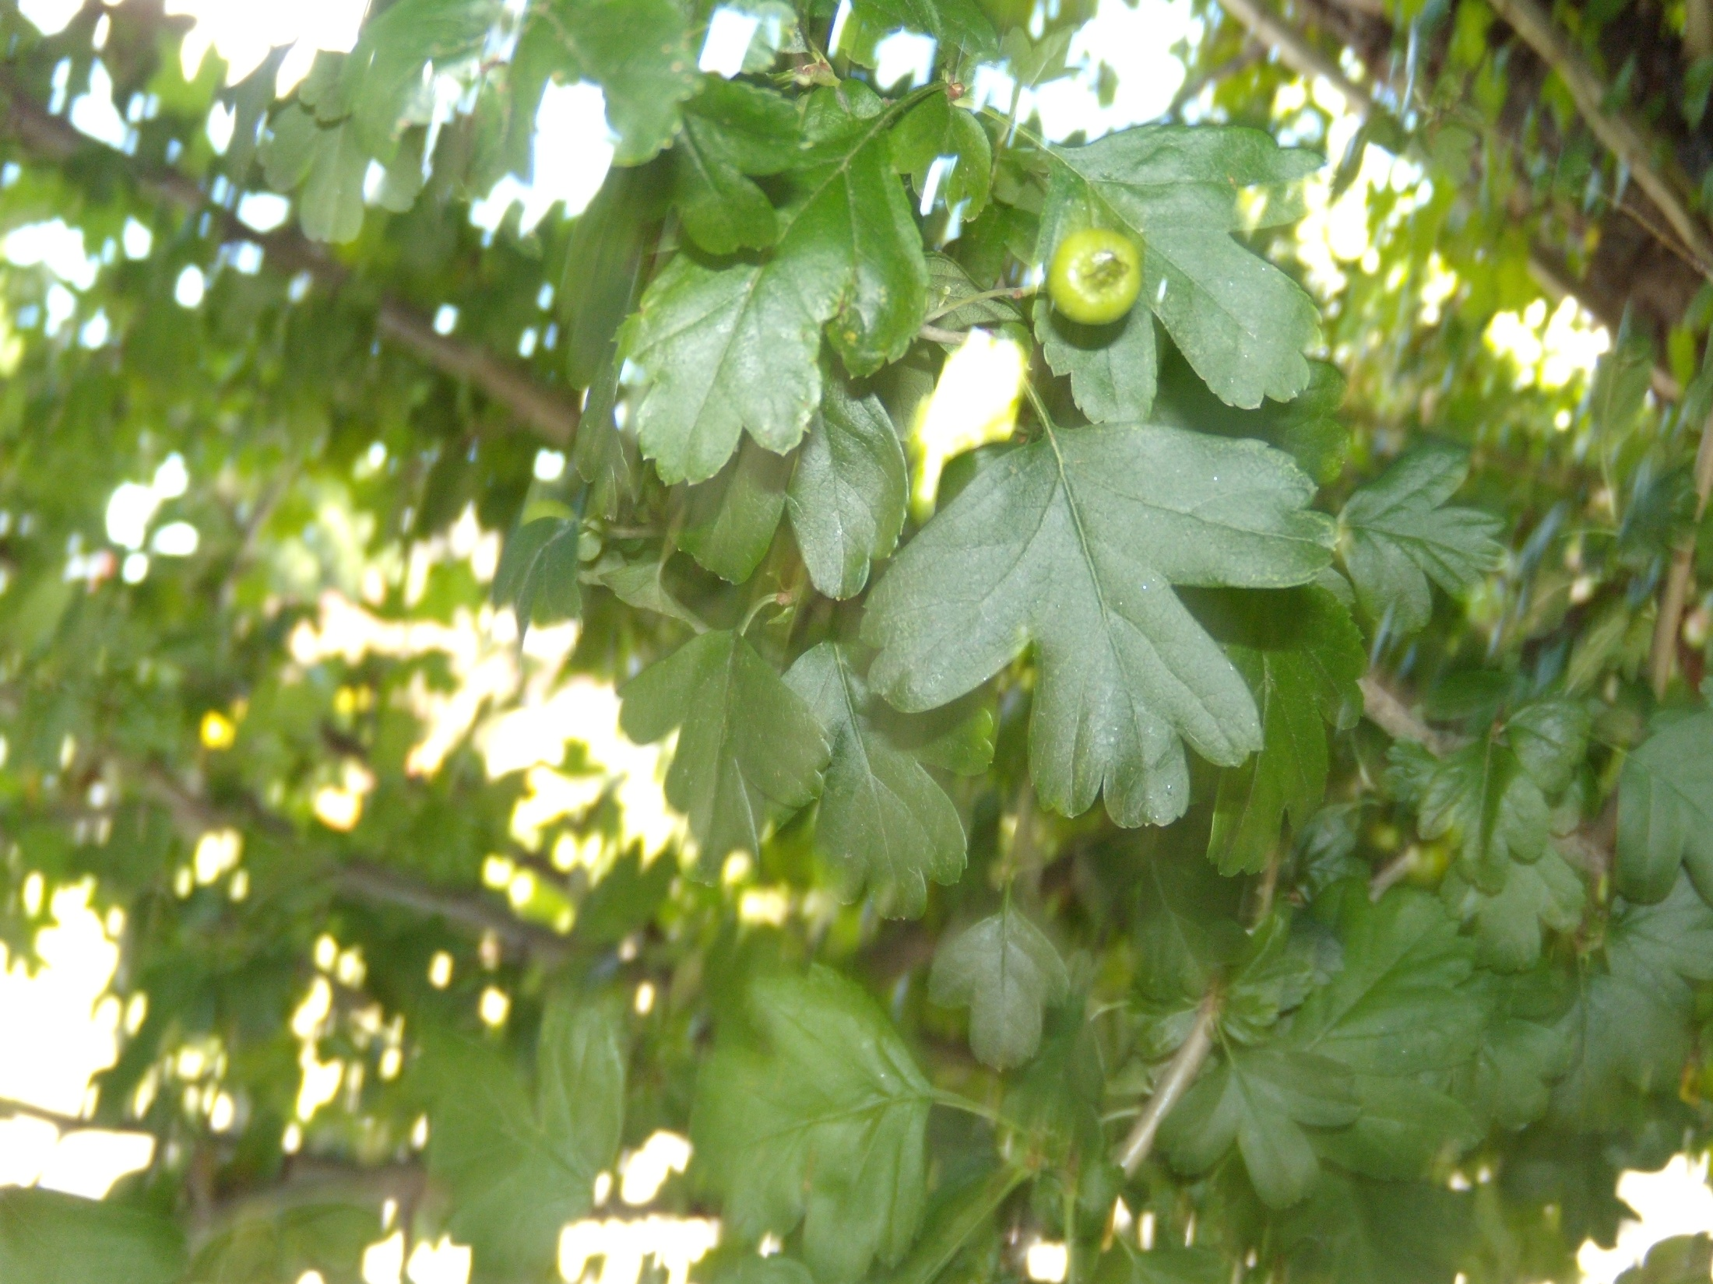

Slide 42
Hawthorn Berry
One of the safest herbs - no side effects
Use berries, bark, flowers, leaves
Treats many cardiovascular diseases, alleviates angina, prevents and treat arrhythmias, improves structure of arteries, prevents and treat atherosclerosis, improves blood circulation (dilates coronary and other blood vessels), improves delivery of oxygen to the heart, calcium channel blockers (relax and widen blood vessels and slow the heart rate), alleviates congestive heart failure, strengthen heart contractions, lowers blood pressure
Notes:
Angina – by improving blood circulation
Arrhythmias... Wireless technology, ground your feet... Walk on bare earth
Calcium channel blockers, or calcium antagonists, treat a variety of conditions, such as high blood pressure, migraines and Raynaud's disease.
Calcium channel blockers prevent calcium from entering cells of the heart and blood vessel walls, resulting in lower blood pressure. Calcium channel blockers, also called calcium antagonists, relax and widen blood vessels by affecting the muscle cells in the arterial walls.
Some calcium channel blockers have the added benefit of slowing your heart rate, which can further reduce blood pressure, relieve chest pain (angina) and control an irregular heartbeat.

Slide 43
Hawthorn Berry
Alleviates diarrhoea, posses potent antioxidant properties, deactivates free radicals, lowers cholesterol, protects the heart against hypoxia (heart is deprived of oxygen), alleviates sore throat
Emotional stress, insomnia, nervous disorders, adrenal function, energy and endurance. Sore throat, pleurisy, gout, arthritis, rheumatism, hot flushes, diarrhoea, spleen, stimulates red blood cells

Slide 44
Hawthorn Berry
It take 1-2 months before effects can be noticed
Can be safely used for long periods of time without any risk or side effects, not accumulative or toxic
Caution: Do not use if taking digitalis

Slide 45
Calendula

Slide 47
Calendula
Flower heads, petals....calendula officinalis, flowers are edible
Alleviates inflammation of colitis, mild digestive ailments, liver, kidneys, gallbladder, stimulates bile, decreases body odour, alleviates edema, bladder infections, cleanses blood
Notes:
Caution... Can stimulate bile so effectively the biliousness can result

Slide 48
Calendula
Inhibits or kills some detrimental bacteria, staphlococcus, gardnerella vaginalis, inhibits inflammation, inflamed lymph nodes, accelerates post pregnancy healing for Ceasarean births
Notes:
Caution... Can stimulate bile so effectively the biliousness can result

Slide 49
Calendula - topically
Oils: Hemorrhoids, nosebleeds, varicose veins, eye ailments (strengthens eyesight), hair rinse, aching feet, gingivitus, mouth ulcers, periodontal disease, ear infections
Topically in tea or oil: Cervicitus, painful periods, inflamed uterus (all douches), vaginitis, acne, bed sores, blisters, bruises, burns, insect bites or stings, itches, psoriasis, radiation therapy burns, babies rashes, shingles, tinea, all wounds

Slide 50
Calendula - topically
Petal poultice: calluses and corns
Caution: Do not over consume if liver is sluggish. It may stimulate bile too rapidly and cause biliousness, wounds may heal too quickly over stitches

Slide 51
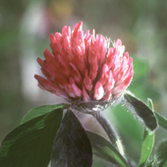
Red Clover

Slide 52
Red Clover
Especially good to purify blood, increases elasticity of women’s blood vessels due to declining estrogen during and after menopause, increases hemoglobin levels, prevents hypertension, alleviates colitis
Prevents breast and ovarian cancer, enhances function of the spleen, alleviates asthma, coughs, eczema, psoriasis, cleanses skin
Along with carrot juice, grape juice, red clover is an exceptional herb for all cancers
Notes:
Breast and ovarian cancers it binds to receptors in breast and ovaries which stop the initiating of cancer cells

Slide 53
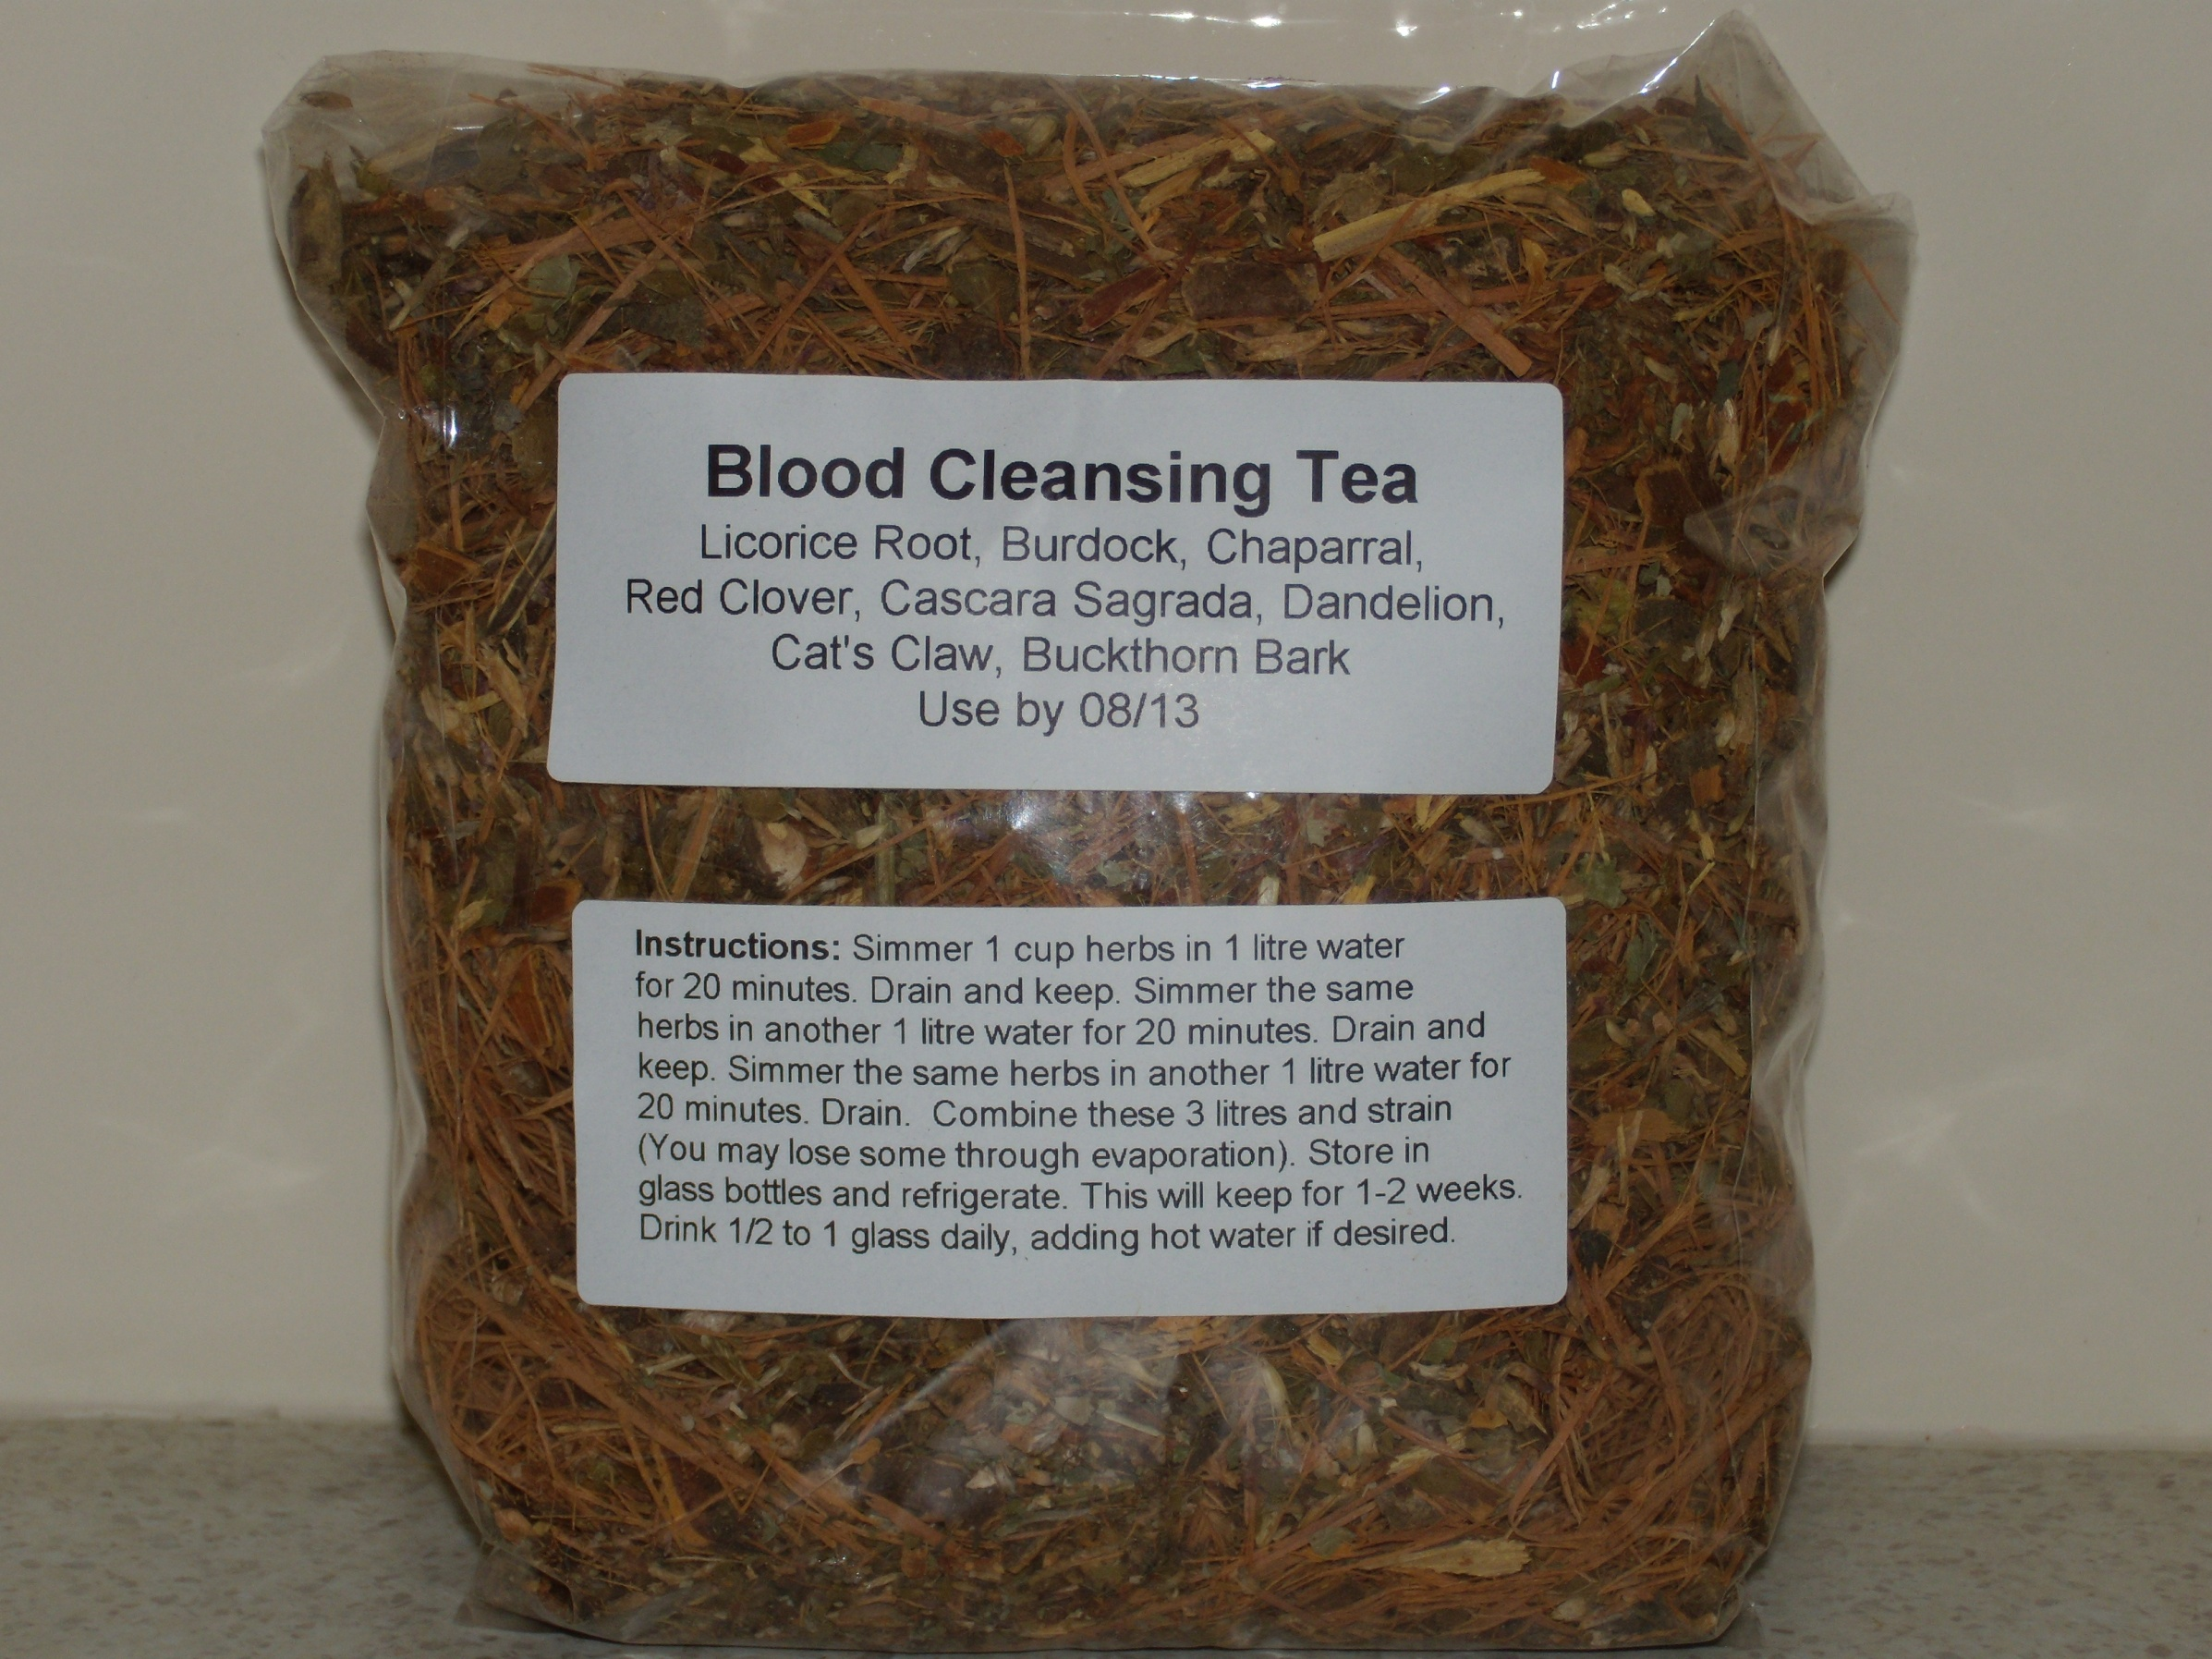

Slide 54
Burdock: A bitter herb that reduces inflammation and controls bacterial infection. It is used for skin diseases and inflammatory diseases due to chronic toxicity eg eczema, psoriasis, gout.
Buckthorn: A bitter, cooling purgative herb that cleanses toxins from the tissues and has diuretic effects. It is used internally for constipation, skin diseases, intestinal parasites and gallstones.
Licorice Root: A sweet, soothing herb that is anti-inflammatory and expectorant, controls coughing, has hormonal effects. It detoxifies and protects the liver. Used for adrenal exhaustion, asthma, bronchitis, coughs, peptic ulcers, arthritis and allergic complaints.
Chaparral: A strong-scented herb, aids adrenals, digestion, kidneys, liver, immune system, arthritis, is an anti-oxidant and it used to treat various forms of cancer.

Slide 55
Red Clover: A sweet, cooling herb that relaxes spasms, and has diuretic and expectorant effects. It is used for skin complaints, cancers of the breast, ovaries and lymphatic system, chronic degenerative diseases, gout, whooping cough and dry cough. It cleanses the blood stream.
Cascara Sagrada: A bitter astringent herb that has a tonic effect on the liver and digestive system and acts as a laxative. It is used for chronic constipation, colitis, digestive complaints, haemorrhoids, liver problems and jaundice.
Dandelion: A bitter herb that acts primarily as a tonic especially for the liver. It is used for menstrual problems and anaemia.
Cat’s Claw: A great herb that is viral, fungal and targets the immune, intestinal and cardiovascular system.

Slide 56
Herbs
for your
Health

Slide 57
How to take herbs
Herbal teas, infusions – 1 t dried herb per cup, pour boiling water over dried herbs, cover and sit for 10-20 minutes, strain
Decoctions – 2 t dried herb per cup, add cold water, bring to boil and simmer covered for 20 minutes, cool and strain
Fresh leaves – 2 t freshs herb per cup, pour boiling water over fresh finely cut leaves
Tincture – alcohol, apple cider vinegar, glycerine
Soaked in oil

Slide 58
St John’s Wort

Slide 59
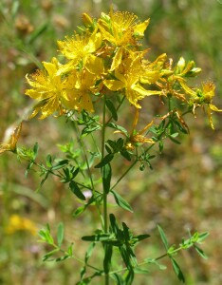

Slide 60
St John’s Wort
Helps prevent some cancers – colon, leukemia, stomach, inhibits growth of detrimental bacteria, suppresses inflammation, some viruses, AIDS, HIV, hepatitis B, herpes virus
Is an antioxidant, alleviates fatigue when accompanied by depression, alleviates symptoms of fibromyalgia
Notes:
A Shrubby perennial herb with leaves that are covered with transparent oil glands that look like holes.
Use the aerial parts, including flowers
Hypericin content

Slide 61
St John’s Wort
Reduces aggressiveness, improves anxiety, reduces apathy, alleviates depression, insomnia, obsessive-compulsive and seasonal affective disorders, tension, irritability
Alleviates the common cold, influenza, symptoms of pre-menstrual syndrome, heart and circulation, bed wetting, kidney stones, gastric problems, worms, anemia, menopause difficulties, congested lungs,
Notes:
Protects heart strengthens cardio vascular system

Slide 62
St John’s Wort
Increases release of melatonin from the pineal gland, inhibits the uptake of dopamine, increases serotonin, headaches and neuralgia, any nerve pain, sciatica
Is equal to or superior to Imipramine (drug used to treat depression
Notes:
Serotonin –important neurotransmitter in brain.... Tryptophan is needed to make serotonin
Reduces effectiveness of contraceptive pill

Slide 63
St John’s Wort
Topically: itching, burns, wound healing, bruising, nerve pain, anti inflammatory action
Do not use when on depression medication, contraceptive pill, warfarin, pregnancy, may cause photosensitivity

Slide 64
Aloe Vera
Over 400 species aloe barbadensis: leaves long and grey, 30-80cm, flowers bright yellow on maturity, when leaf is cut it has a strong smell
aloe candelabra: 1-2 metres tall, spans 2 metres, has side branches aloe perryi: does not grow tall, pup profusely, flower apricot/orange shade, therapeutically not as potent as barbadensis
Notes:
Insects don’t bother it
Can be blended with water and added to foliar sprays
Cut off leaf at base, leaf mends itself
Aloe grown in many homes in Europe

Slide 65
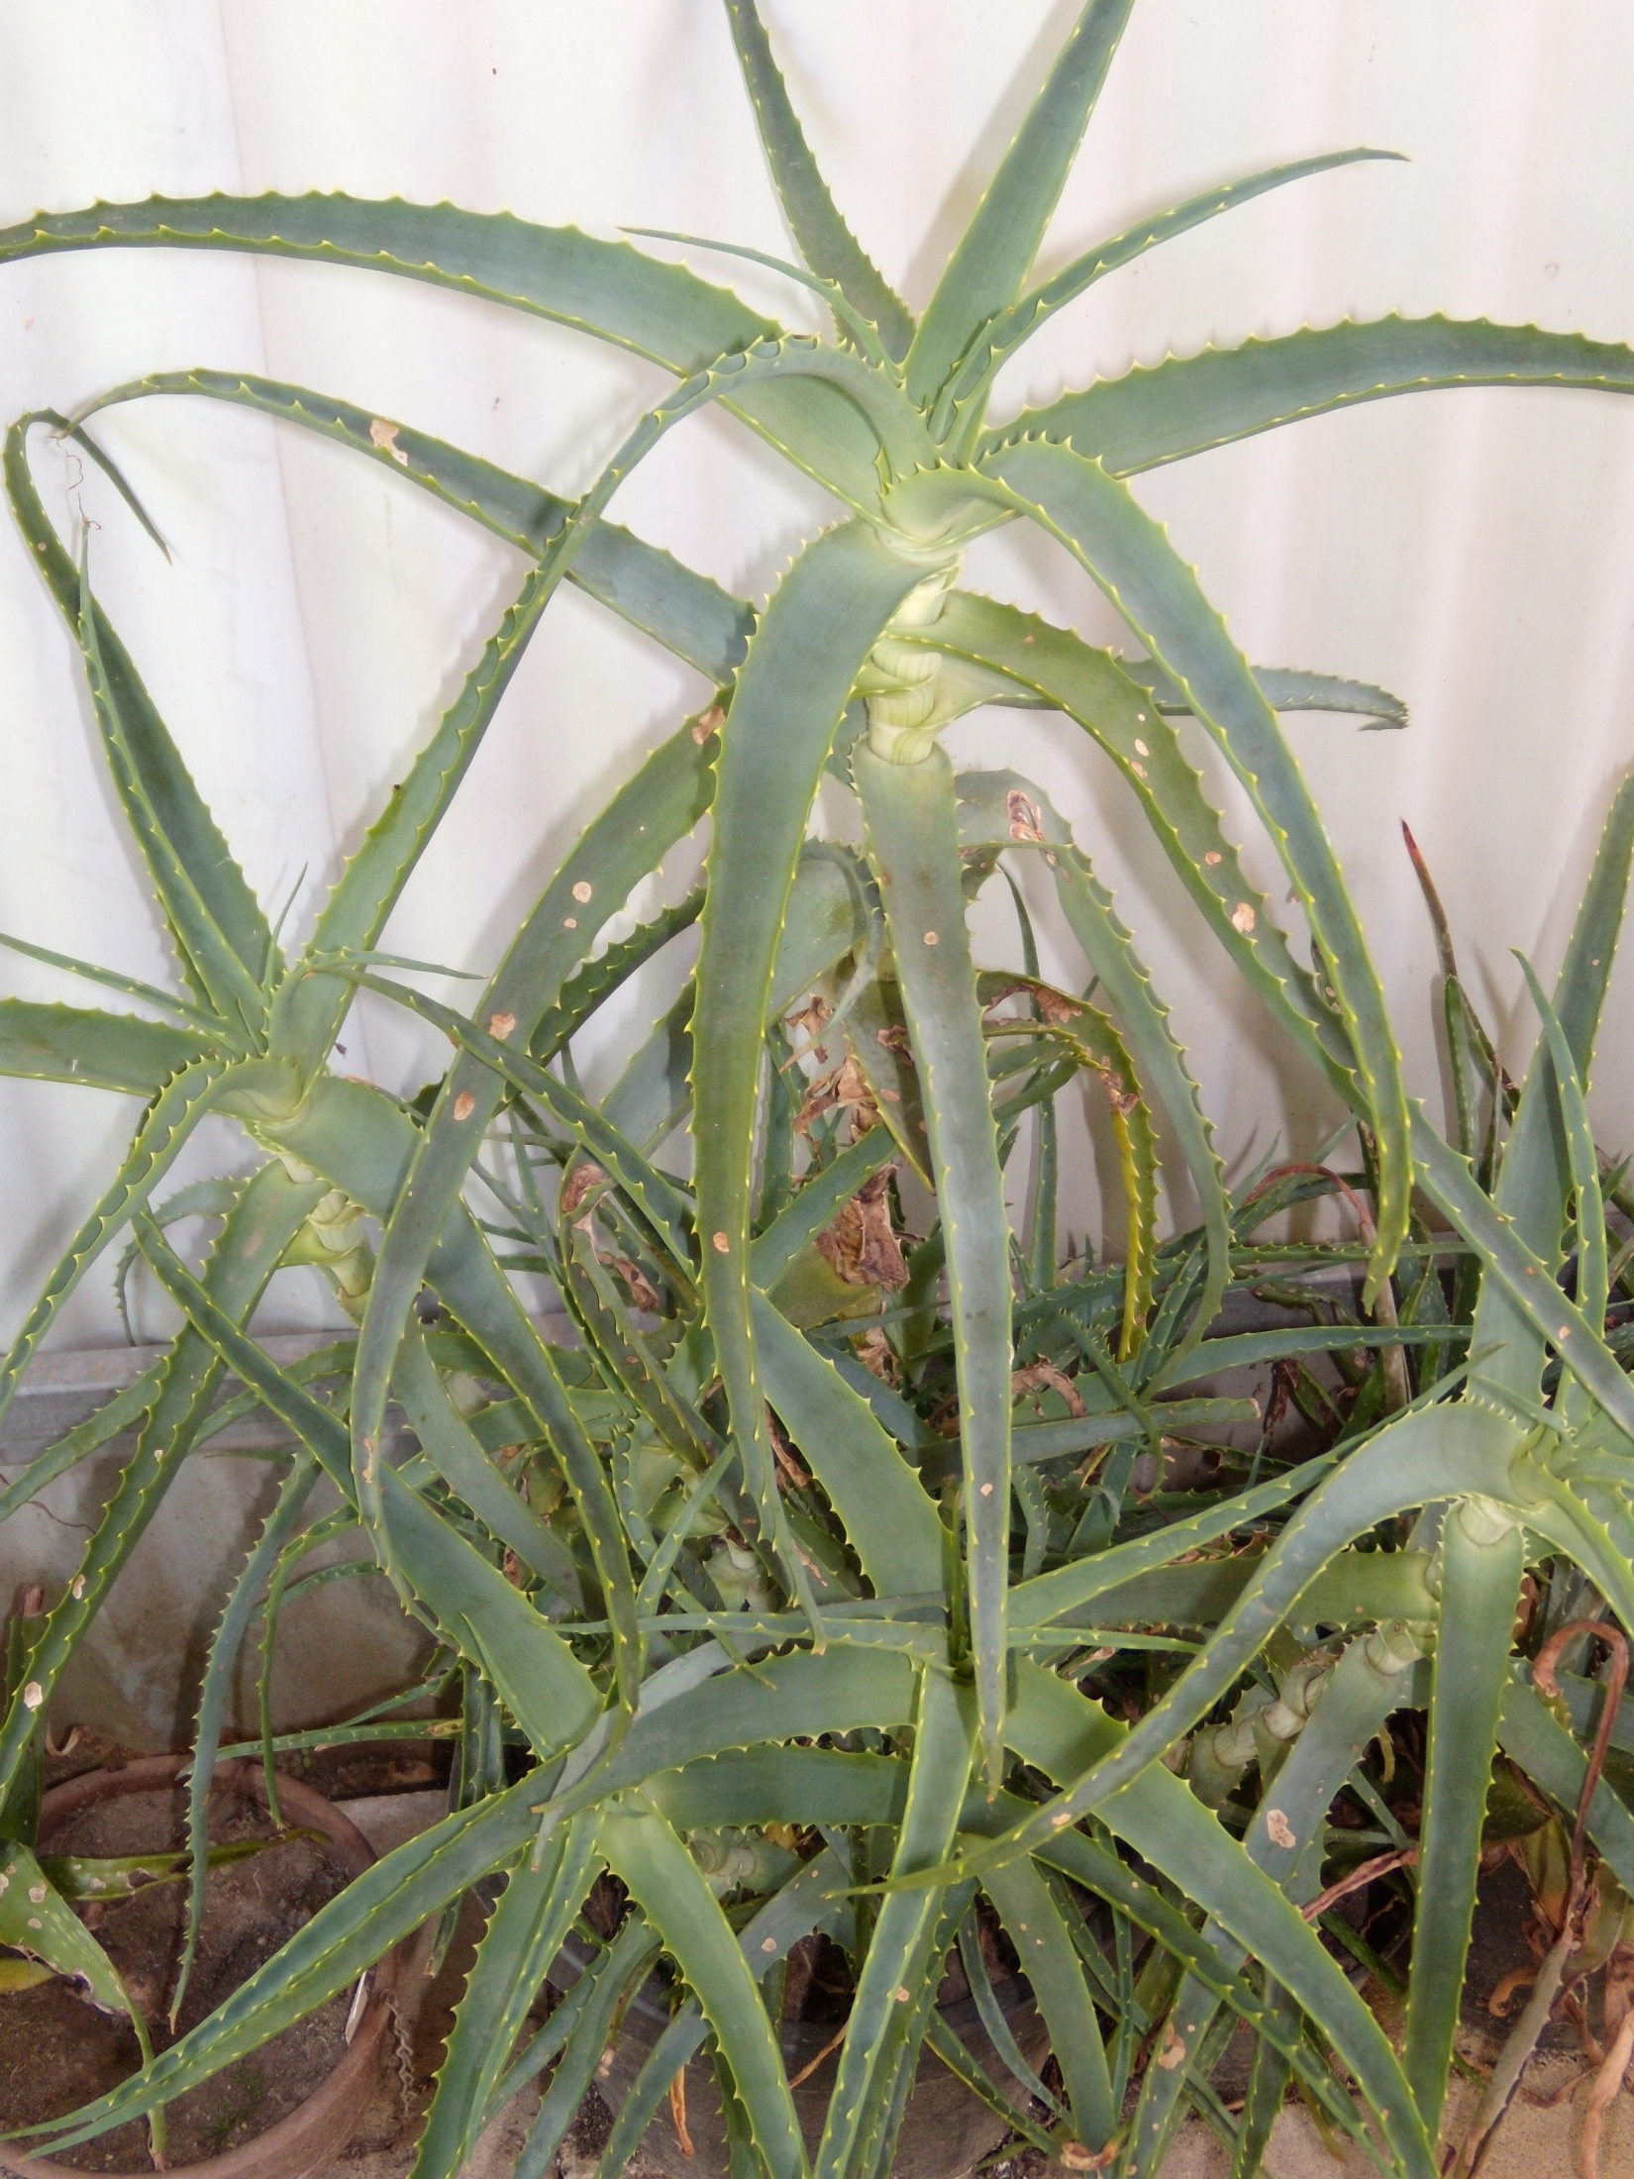

Slide 66
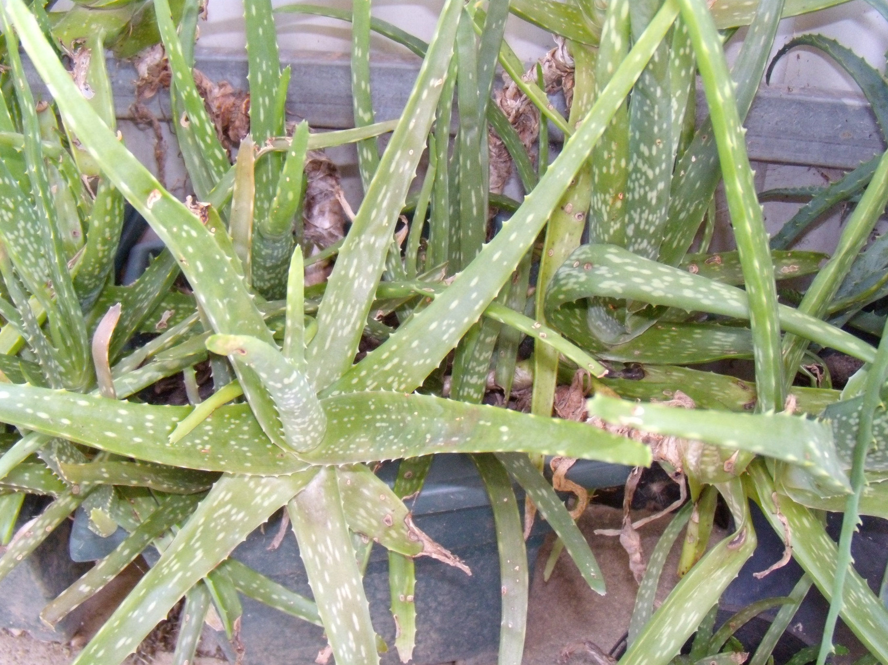

Slide 67
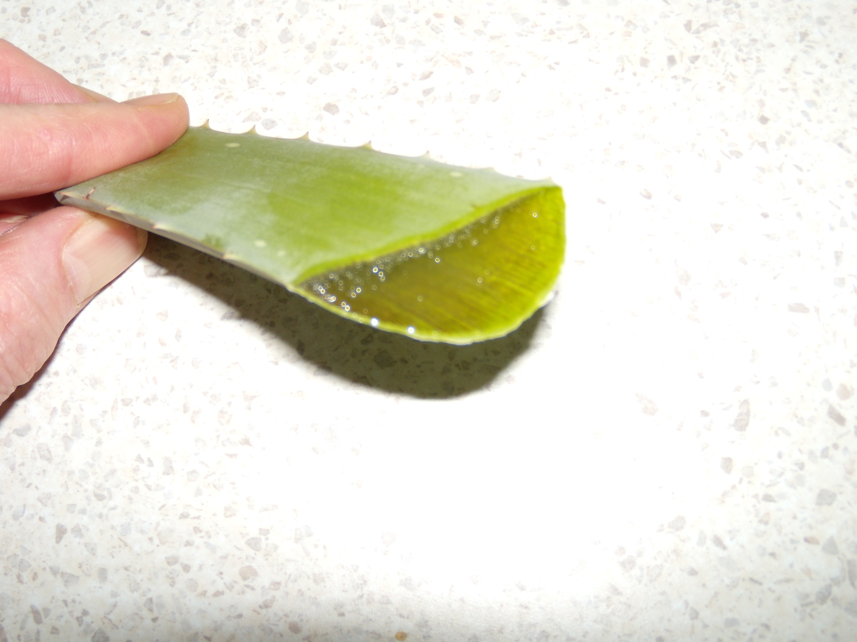

Slide 69
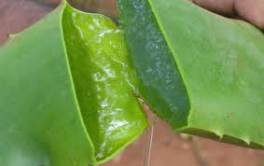

Slide 70
Aloe Vera
Alleviates inflammation of the colon, Crohn’s disease, irritable bowel, ulcerative colitis, constipation, heartburn, too much acid, peptic ulcers, duodenal ulcers
Asthma – mix with honey, dessertspoon 3x daily

Slide 71
Alleviates allergies, inhibits metastasis in some types of cancer including liver cancer, reduces fever, reduces inflammation, enhances immune system, inhibits some viruses: AIDS, HIV, herpes, influenza, measles
Alleviates chronic fatigue, fibromyalgia, rheumatoid arthritis, asthma, pneumonia, reduces blood sugar in diabetes

Slide 72
Aloe Vera - topically
Heals abscesses, keratoses and some skin cancers, burns, itching from hives, insect bites, psoriasis, dermatitis, prevents scarring, cleanses skin, heals skin ulcers, alleviates sunburn, shingles, tinea, eliminates warts, accelerates healing of wounds, has antiseptic qualities, penetrates deeply, stops bleeding, aftershave, hair jel after shampooing, smooths wrinkles, freeze chunks and insert into rectum for hemorrhoids, stretch marks, infected fingernails, vaginal thrush

Slide 73
Increases circulation by dilating capillaries, alleviates frostbite, prevents detrimental bacteria and fungi from penetrating skin, heals mouth ulcers, alleviates leukorrhea and vaginitis (resulting from a trichomonas infection)
Research – reaches deepest body tissue - penetrates 7 layers of skin
Said to restore hair colour
Pets and animals, gel into horses eye for cancer, mange cured in dogs

Slide 74
How to take aloe
Cut leaves at base of plant. Allow to stand half and hour for yellow sap to drain. Cut into 2cm chunks and place pieces into glass jar (filling it to about one third). Cover with water and allow to steep in fridge for about 8 hours. Pour off a glassful and drink . After draining you can refill the jar with water and reuse the aloe for about a week. The infusion will get milder and weaker, but it is still beneficial. Can be used to take chlorine taste out of water

Slide 75
Prepare as 100% juice. Pick large leaves, cut skin off, rinse off yellow sap with water. Place in blender. For 3 cups gel add 1 teaspoon vitamin c powder and blend at low speed. Place in covered container in refrigerator. Take 2-5 tablespoons daily, mixed with water or juice. This is most effective way to reap benefits of aloe. You can use prepared juice if you wish
Use aloe with care. It may cause cramping of the bowel (add a little dried or fresh ginger with it

Slide 76
Maca
Grown high in harsh climate in Peru, stable for years, nutritional superfood
Adaptogen (restores balance), increases energy levels in chronic fatigue, alleviates fatigue, improves stamina and endurance, improves alertness and mental clarity, ability to handle stress, any thyroid problem, anemia, osteoporosis
Notes:
Delicacy, sweet butterscotch flavour, super food
Can be used as flour in cooking
Adapts and improves all body systems (exert a normalizing influence on the body, neither over-stimulating nor inhibiting normal body function, but rather exerting a generalized tonifying effect).
Natures viagra

Slide 77
Maca
Alleviates female infertility, symptoms of female menopause (HRT alternative, vaginal dryness, depression, PMT), male impotence, male menopause, male infertility, increases sexual desire, improves sexual performance, increases testosterone levels, any hormonal imbalance
Safe alternative to anabolic steroids used by weightlifters

Slide 78
Herb Robert

Slide 79
Herb Robert
Used in Europe as a traditional herb for cancer that is able to supply a natural dose of radiation. It contains ellagic acid which slows growth of tumours caused by certain carcinogens
Herb Robert is a source of germanium, a valuable element to the body, as it has the ability to make oxygen available to the cells.
Notes:
Herb Robert is a source of germanium, a valuable element to the body, as it has the ability to make oxygen available to the cells. More oxygen at cell level, means the body has the opportunity to fight disease by its own powers and healing can take place quickly. Lack of free oxygen available to the cells can be caused by free radicals and a toxic state around the cells meaning the cells cannot get the required oxygen or the nutrients to regenerate. The area becomes anaerobic, the beginning of pain, disease, wayward cells and cancer.
Herb Robert self-seeded at our kitchen door Dr. Otto Warburg, Nobel Prize winner, said in 1966, "The prime cause of cancer is lack of oxygenation of the cells". He discovered that riotous, wayward cancer cells could not exist in the presence of abundant oxygen, but only in an anaerobic state. Because oxygen plays such an important role in cell health and immune function, using Herb Robert regularly is a powerful contribution to maintaining robust good health and well-being.

Slide 80
Dr. Otto Warburg, Nobel Prize winner, said in 1966, "The prime cause of cancer is lack of oxygenation of the cells". He discovered that riotous, wayward cancer cells could not exist in the presence of abundant oxygen, but only in an anaerobic state. Because oxygen plays such an important role in cell health and immune function, using Herb Robert regularly is a powerful contribution to maintaining robust good health and well-being.”

Slide 81
Herb Robert
Has homeostatic and antibiotic action, a digestive aid, blood cleanser and body detoxifier, diarrhoea, diabetes (stabilizes blood sugar), shingles, enteritis, inflammation, rheumatism and arthritis, peptic ulcers, kidney diseases and stones, hemorrhages, herpes, colds
Lethargy, adrenal gland diseases, impotency, gout, liver ailments, mucus congestion, infectious sores, gastritis, hemorrhoids painful inflammation around finger and toe nails, eye irritations, chronic fatigue
Notes:
Enteritis – inflammation of small intestine The herb has come to the rescue. as a gargle, for many people with mouth ulcers, bleeding gums and sore throats, Rub bruised, fresh leaves over the area, or use the herb, made into a tea, as a mouth rinse and gargle. Several diabetics have found using herb robert, regularly, has helped to stabilise blood sugar levels. Herb robert is used to help clear colitis (inflammation of the colon) which interferes with the normal, wave-like motion of peristalsis, causing cramps, constipation and mucus discharge. Chronic fatigue is being relieved, for people who start on the herb. It was valued highly as a wound herb, no doubt due to its astringent properties, and it was also thought to be a herb capable of mending fractures. In Europe, it is seen growing wild, and has been a traditional herb for cancer as it was believed to be "a dose of natural radiation". Rudolph Breuss, in his book, "Cancer and Leukaemia", gives advice for treatment of cancer and other, seemingly incurable, diseases, saying that: besides the vegetable juice regime, and kidney tea, herb robert is essential, when dealing with all cancers, as it stimulates the kidneys to reject and eliminate poisons. He recommended that a pinch of the herb be steeped in 1 cup of boiled water for 10 minutes and drunk, cold, daily. In one chapter in the book, he wrote on infertility recommending for couples who have had difficulty conceiving that both husband and wife should sip a cup of herb robert daily (made the same way as for the cancer treatment above). He knows this method is effective, from feedback he has received. In his "hints for farmers" he recommends a handful of herb robert, mixed with concentrates and a little salt, fed to cows (for 3 days) that cannot come into calf. The astringent action, of leaves and stems of the plant, has been valued from mediaeval times, for healing wounds and to stop bleeding: which gave it the common name, 'bloodwort'. For external use, the juice from crushed leaves is rubbed on sunspots, rashes and sores; or leaves made as an infusion are used as a wash or a poultice. A hot poultice made of steeped leaves is said to be soothing to bladder pains, neuralgia, bruises, fistulas and persistent skin problems. Another application of the herb has been as a foot infusion, said to help remove toxins, heavy metals and radiation from the body. This is highly recommended for people who have been subject to many x-rays, or people continually working in the fields of computers, mobile phones, and other electronics, giving off ELF and VLF radiation, infrared and microwave irradiation, and x-rays. To make a Foot Infusion: take a handful of chopped herb, place into a bowl (large enough to rest both feet in) pour 4-5 cups of boiling water over it and stir, vigorously. Then add cold water, to adjust to heat bearable to place feet in. Sit in a comfy chair with your feet in the bowl for 15 minutes, relax and read your favourite herb book. This is also excellent therapy for tired or aching feet. The original article I was given, stated that, for cancer treatment, the method of use was to take the leaves and stems of herb robert (either dried and powdered or finely chopped, fresh leaves) to make a heaped teaspoonful. This was mixed well with a fresh, raw egg-yolk, taken first thing in the morning, on an empty stomach. Don't be put off by the thought of the raw egg-yolk, as believe me, it is quite palatable. The finer the herb is cut the easier it is to swallow. Note, it only smells like foxes (to me); the flavour is not unpleasant. Approximately 20-25 large leaves and stems (10-1 5cm long) are required to make 1 teaspoonful of finely Chopped leaves. To keep up this daily dose, quite a number of plants need to be growing and well established to have sufficient leaves for a daily supply. For people who require a consistent, ongoing, supply of leaves, I recommend that as plants flower and set seed, that these be handpicked. Seed is mature when the capsule is 2cm long, with the oval seed receptacle being plump and hard, when felt with 2 fingers. Nip off the hard capsules and leave to dry 3-4 days. grow seeds. in large pots, a shady spot in the garden or styrofoam fruit boxes are ideal, as they can accommodate a thick planting of seeds. Cover seed with 5mm of fine soil. Water regularly, so the soil does not dry out. Germination can take from 2-6 weeks, depending on temperature and climatic conditions. For people using the herb daily with raw egg-yolk, it is advisable to get 6-10 styrofoarn boxes of plants established, and also to maintain an ongoing regime of regular seed planting. It is the consistent, daily, use of the herb that is important to improved health. For any other therapeutic use, or people wishing to use it as a preventative and strengthen their immune system, the leaves and stems (fresh or dried) can be used as a tea, sweetened with honey, if desired. Some people blend the leaves together with fruit juice, or add to vegetables and fruits when juicing.

Slide 82
Herb Robert
Skin conditions, bruises, mouth ulcers, bleeding gums, sore throats, colitis (inflammation of the colon), infertility
Most importantly it is an excellent herb for cancers of the lungs, mouth, oesophagus, bowel, prostate, breast, uterus, spine, lymph, and other cancers including skin cancer
Use as a wound healer, bone fractures, haemorrhaging

Slide 83
Herb Robert
It has the ability to make oxygen more readily available to the cells in the body
It can stimulate electrical impulse at a cellular level
Works on the immune system

Slide 84
Herb Robert
Enhances energy levels
Is a powerful healing agent
Has an antibiotic, antioxidant and antiviral benefit

Slide 85
Herb Robert
Can be made into tea
Use leaves daily, chopped and eaten over food, in salads, in juice, in a smoothie, or in way that suits you lifestyle, either dried and powdered or finely chopped, fresh leaves to make a heaped teaspoonful
Use tea in a foot bath to detoxify and remove heavy metal and radiation from the body (including radiation for electronic equipment)

Slide 86
Sage

Slide 87
Sage
Herbal folk lore has venerated it as a sacred herb capable of increasing the life span
Contains pre-cursors to produce adrenal hormones, prevents abnormal blood clotting, prevents and treats heart attacks, alleviates halitosis, reduces perspiration, reduces gray hair and sometimes stimulates hair growth, rejuvenates eyes, brain, glands, nervous system

Slide 88
Sage
Reduces fevers, reduces blood sugar in diabetics, alleviates fatigue, stimulates regrowth of liver, works on kidneys and spleen, reduces excessive mucous discharges
Increases alertness, inhibits further progression of Alzheimer’s Disease, increases concentration, improves memory, alleviates laryngitis, gum disease, tonsillitis, pharyngitis
Alleviates the itching with herpes, insect bites, shingles, psoriasis

Slide 89
Kelp
Contains iodine – essential to proper functioning of the thyroid
Mineral content 20x higher than land grown food
Dry skin, hair disorders, slow growth in children, delayed maturity, fatigue, better concentration, cleanses and tones blood vessels, normalizes blood pressure, stimulates immune system, takes excess acid from body
Notes:
People who take lots of iodine lose weight far more easily
Iodine stimulates their thyroid which boosted their metabolism
High sodium content clears obstructions in gall bladder

Slide 90
Kelp
Great for vital energy, liver congestion, gall bladder, cleanses and strengthens colon, stimulates pancreas, cleanses and tones kidneys, prostate gland health, female organs, painful menstruation, arthritis, rheumatism, calms nerves
Notes:
People who take lots of iodine lose weight far more easily
Iodine stimulates their thyroid which boosted their metabolism
High sodium content clears obstructions in gall bladder

Slide 91
Kelp
Protects against radiation, toxic heavy metals
people who take lots of iodine lose weight more easily as it stimulates thyroid which in turn boosts their metabolism – great treatment for obesity

Slide 92
Pau D’Arco
Treats candida albicans, inhibits cancer – breast, Hodgkin’s disease, detrimental bacteria, fungi and some types of viruses, some types of intestinal parasites, malaria
Rheumatism, tuberculosis, eczema
Can cause nausea or vomiting
Notes:
South American herb

Slide 93
Chaparral
Indians regarded it as a cure-all
Mexicans called it the Governess of the body because it cured so many ailments
Increases vitamin C levels in the Adrenal Glands, powerful antioxidant, extends life in lab animals, anti-tumour effect, Crohn’s disease, ulcerative colitis, protects against excessive radiation, improves function of kidneys

Slide 94
Chaparral
Inhibits the HIV virus implicated in AIDS, kills some detrimental bacteria, protects against some forms of cancer, treats skin cancer, reduces inflammation, stomach ailments, pulmonary and throat complaints,
Improves function of the liver, blood cleanser, arthritis, rheumatism, alleviates leg cramps, retards tooth decay, alleviates pain, improves function of the lungs, alleviates acne and boils, heals bruises and eczema

Slide 95
Garlic
Considered by some Herbalists as a Master herb
Inhibits aging process, prevents angina, atherosclerosis, abnormal blood clotting, improves blood circulation and the elasticity of blood vessels, lowers fibrinogen (clotting factor), alleviates some ailments of the heart, reduces the risk of heart attack, thins blood, lowers elevated blood pressure, improves intermittent claudication, inhibits platelet aggregation, prevents thrombosis

Slide 96
Garlic
Stimulates normal cell death in some types of cancer, alleviates dysentery, eliminates intestinal parasites, roundworm, hookworms, tapeworms
Alleviates otitis externa (swimmer’s ear or any ear ache), diuretic, antioxidant, deactivates free radicals, lowers cholesterol, lowers blood sugar levels in diabetes, detoxifies liver, treats obesity, increases stamina, lowers triglycerides, rheumatiod arthritis, meningitis

Slide 97
Garlic
Prevents some forms of cancers: bladder, breast, colon, esophagus, leukemia, liver, lung, lymphomas, Burkitt’s lymphoma, prostate, skin, stomach, melanoma
Stimulates immune system, kils or inhibits some types of detrimental bacteria, fungi, protozoas, viruses: HIV, AIDS, cold, influenza, papillomas
Alleviates asthma, bronchitis, sissolves mucus in lungs, sinusitis, whooping cough (inhale vapours), ammenorrhea (suppressed menstruation), alleviates PMS, psoriasis, tinea, acne

Slide 98
Garlic uses
Garlic soaked in olive oil - Russian penicillin. Peel and cut or mince garlic. Cover with olive oil and steep for 2-3 days. Strain. Use up to 2 tspns 3 or 4 times daily
This oil can be taken internally or rubbed on skin
For cold and upper respiratory infections: place a clove in mouth between teeth and cheek. Cold will disappear within a few hours to 1 day.
Wounds: garlic placed on unclean wounds will cleanse them in 4-5 days (used in WW1). Grated garlic will kill virulent bacteria within 5 minutes.

Slide 99
Herbs
for your
Health

